Slide 1

Quant Week 9
4/11/24
Notes:
Complete

Slide 2

Agenda
Icebreaker Question
Updates
Brainteasers
Project

Slide 3
Ice Breaker
Favorite Superhero

Slide 4
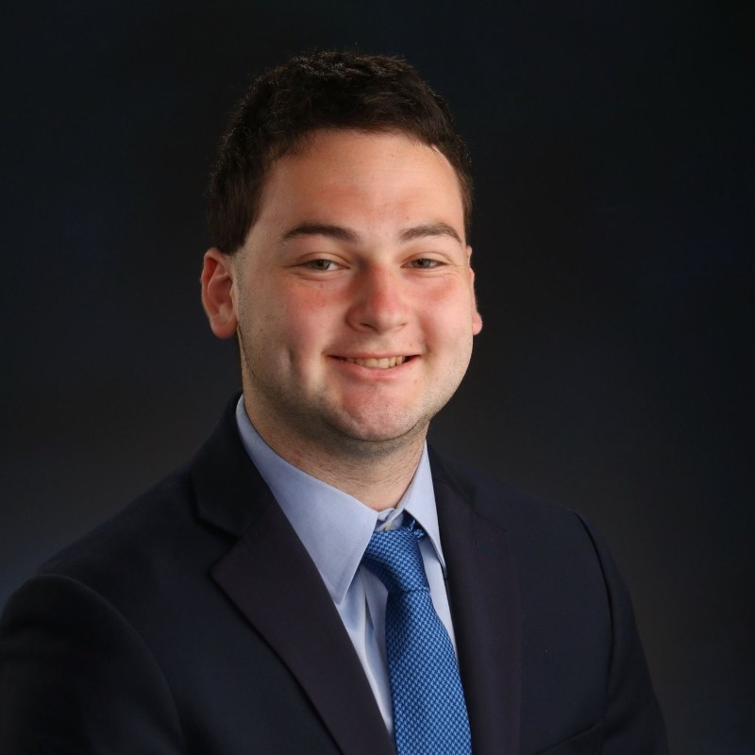

IMC Sponsorship!
Happening Now
IMC Event
April 16th 6pm
Location TBA
Referal Code: 3MRLW8

Slide 5
Brain Teaser - Even Coin Flips
Paul flips a fair coin until he gets two consecutive heads or tails for the first time. What is the probability that he flips the coin an even number of times?

Slide 6
Brain Teaser - Even Coin Flips Solution
Let E denote the event that Paul flips the coin an even number of times and F_{i} denote the result of the i-th flip. Then conditioning on the first flip, we see
P(E) = ½ P(E|F₁ = H) + ½ P(E|F₁ = T)
P(E|F₁ = H) = P(E|F₁ = T), since the probability that the second toss matches is equal, regardless of what the first toss was.
Equivalently, we have
P(E) = ½ P(E|F₁ = F₂) + ½ P(E|F₁ ≠ F₂)
P(E|F₁ = F₂) = 1, since Paul has two consecutive matching coin flips. In the case that the first and second flips are different, Paul is in the exact same position as he was when F₁ was reached, but with 1 additional flip having been completed. Additionally, if Paul’s third flip matches the second, we have the complement of E occurring, so P(E|F₁ ≠ F₂) = 1-P(E).
Then P(E) = ½ + ½ (1-P(E)), which implies P(E) = ⅔.

Slide 7
Project Discussion/Work Time
Notes:
Idea:
We’ll write the platform to make and conduct trading strategies.
You guys will write and implement the strategies, test them on prior data
Alternate for more software-oriented people you guys could also make the platform
We can do this in python/C++, if python use numPy and Yahoo Finance data
Use matplotlib plot graphs, show that in pdf/md/html file through github

Slide 8
Calculating Variance and Sharpe of PnL
Variance
Given the list of trades, translate this into the raw PnL
Call .pct_change() on the pandas dataframe containing PnL to get returns
Call var() on the returns dataframe to get the variance of returns
Sharpe Ratio = E[Rp - Rf] / σ
Calculate portfolio returns (initial - final / initial)
Acquire Risk Free Rate (use 5% for now or acquire it from US Treasuries)
Adjust the RFR for the time period
Divide by the square root of the variance (standard deviation)

Slide 9

Attendance Form
Link to Onboarding Document, Slack and Team Folder
https://docs.google.com/document/d/1oA2q-qjPCw1bY79zWf1LtpeN_da65L0ntnxzCQSsJRc/edit?usp=sharing
Anonymous feedback form, please fill out!

